Slide 1


Capstone Project
NODUS - ADHD Symptom Detection
24 - 1 - D - 6
Safwan Halabi - 213784127
Bishara Bisharat - 208261990
Supervisor - Dr. Natali Levi

Slide 2
Introduction
1
Our Solution
2
Technologies Used
3
TABLE OF CONTENTS
Deep-Learning Model
4
Final Product
5
Overview of the Problem
Current Solutions
Overview of the NODUS System
Architecture and Components
Overview of the Technologies employed
Architecture, experiment, setup and results, inspirations.
Screenshots and Illustrations

Slide 3


Introduction - ADHD
ADHD is a common neurodevelopmental disorder affecting both children and adults.
It impacts focus, attention, and impulsivity.
Often misunderstood as just excessive energy, ADHD can significantly affect daily life at school, home, and work.
Understanding ADHD helps create better support systems and unlocks the potential of those who have it.
Notes:
Attention Deficit Hyperactivity Disorder, or ADHD, is a common neurodevelopmental disorder that affects millions of children and adults worldwide. It can manifest in challenges with focus, attention, and impulsivity. While sometimes portrayed as simply excessive energy, ADHD can impact daily life at school, home, and work. By understanding ADHD, we can create better support systems and unlock the potential of those who experience it.

Slide 4
Impulsivity
Hyperactivity
ADHD Symptoms
Inattention
Combined
Involves hasty actions without thought, interrupting others, and difficulty waiting for turns.
Characterized by excessive movement, fidgeting, and difficulty staying still.
Marked by difficulty focusing, being easily distracted, and trouble following through on tasks.
Displays symptoms from both hyperactivity/impulsivity and inattention categories.

Slide 5
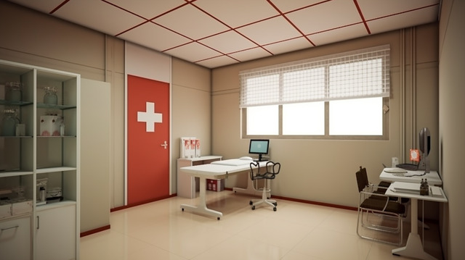
Current Technologies
QUESTIONNAIRES & REPORTS
INTERVIEWS
PHYSICAL EXAMINATION
Gather information from patients or caregivers about ADHD symptoms.
They help spot patterns but depend on honest answers.
They provide a starting point for further evaluation.
Talking with a mental health professional is the main way to diagnose ADHD.
Unlike questionnaires, interviews allow for a back-and-forth conversation, giving a clearer picture of the symptoms.
Helps rule out other medical conditions that might look like ADHD.
It focuses on overall health but cannot diagnose ADHD directly.
Notes:
Questionnaires: Provide Insights: Answers can reveal patterns and areas for further exploration during a professional evaluation. Self-Reported: Accuracy relies on the patient’s/caregiver’s honest assessment of your experiences.
Interviews: Core of Diagnosis: Interviews with a mental health professional are the cornerstone of ADHD evaluation. Interactive Process: Unlike questionnaires, interviews are a two-way street.
Physical Examination: Ruling Out Other Causes: helps to identify medical conditions that can mimic ADHD symptoms. Not Diagnostic for ADHD: The exam itself cannot diagnose ADHD. It's focused on general health and ruling out alternative explanations.

Slide 6




GOAL 1 - Accessibility
GOAL 2 - Accuracy
PROJECT GOALS
Accessibility is a must, as we mentioned in the introduction undiagnosed ADHD is a serious issue which isn’t being treated accordingly, our aim is to help detect possible symptoms and help users to deal with their ADHD.
A detection system which isn’t accurate doesn’t help anyone, our aim is to reach a symptom detection accuracy of over 80%, that way our users can be sure of our system’s results.

Slide 7

Our Product

Slide 8

ABOUT THE PROJECT
Comprehensive Symptom Detection: Combines multiple methods like eye-tracking, vocal analysis, and input from external observers (e.g., parents or teachers).
Advanced AI Integration: Utilizes a Deep Learning model that analyzes empirical data and past patient information to enhance detection accuracy.
Accessible to Everyone with WIFI: Our cloud-based architecture allows users to employ our services from anywhere at anytime, no appointment needed!

Slide 9
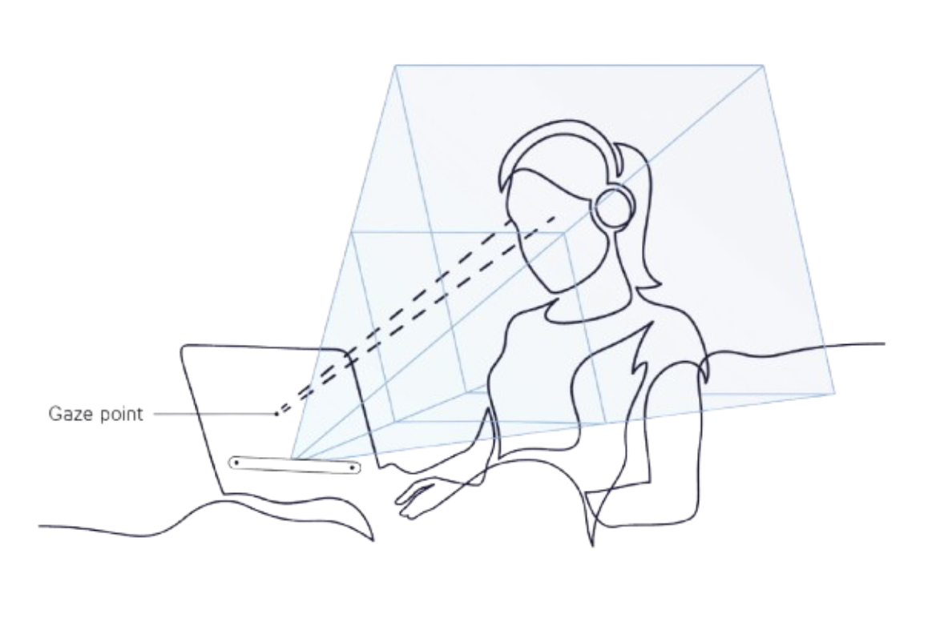
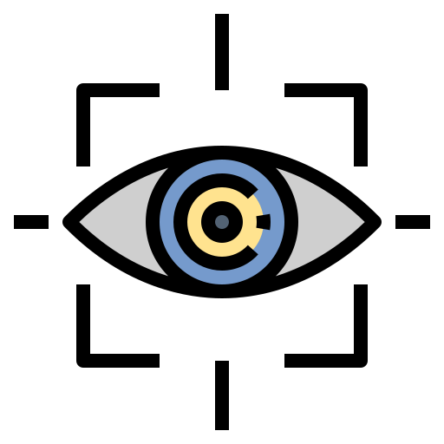
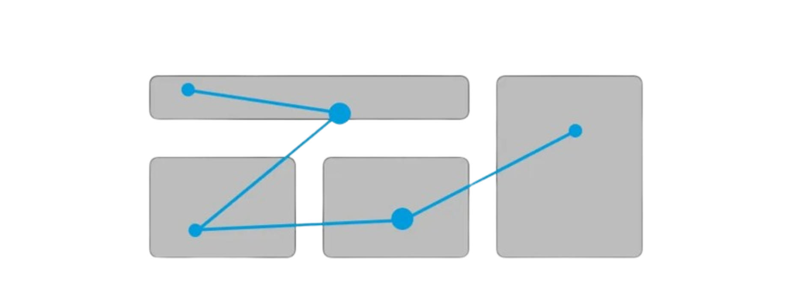
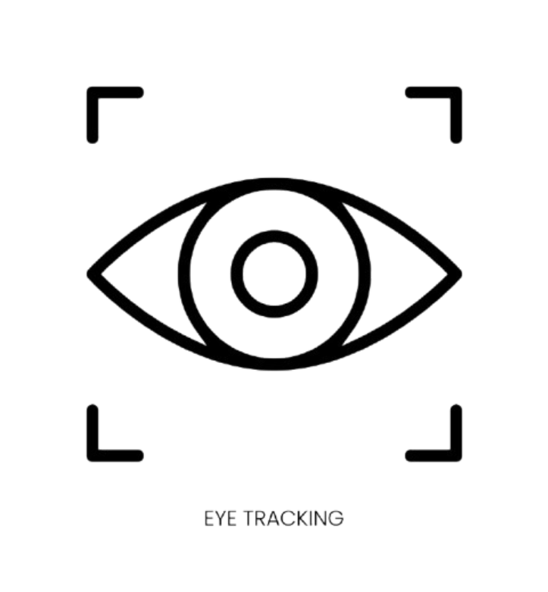
Eye-Tracking
Major Components
In NODUS, we implemented two key tests: a reaction time test and a gaze test.
The gaze test consists of two parts:
Part 1: No distractions, allowing the user to focus on the reaction time aspect.
Part 2: Visual and auditory distractions are introduced to observe changes in focus and attention.
Our primary metric was the squared difference between adjacent pupil positions in the video frames, helping us track eye movements over time.
For easier integration into the deep learning model, we calculated the mean, median, and standard deviation of these squared differences and for the reaction time results.

Slide 10

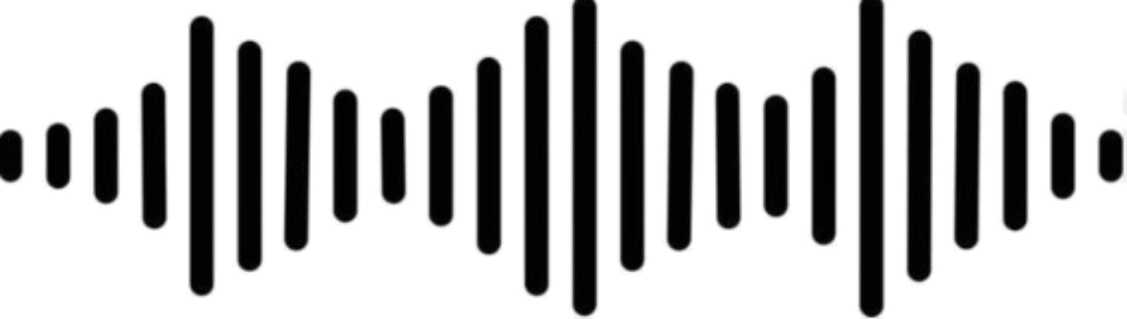
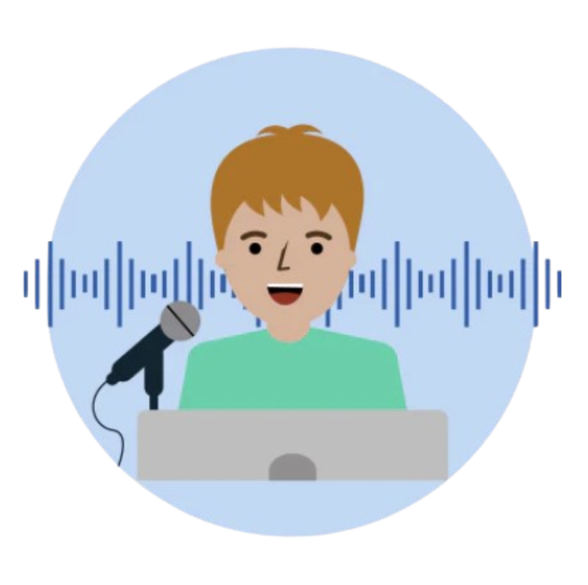
Vocal Analysis
Major Components
Vocal analysis for ADHD is a developing field that examines how a person with ADHD speaks in order to potentially identify signs of the disorder.
What is analyzed: Researchers look at characteristics of a person's voice, such as pitch, loudness, and steadiness. The metrics we have chosen are:
Jitter.
Shimmer.
Harmonics-to-noise ratio (HNR).
Fundamental Frequency (FQ).
Voice Quality Index (VQI).

Slide 11
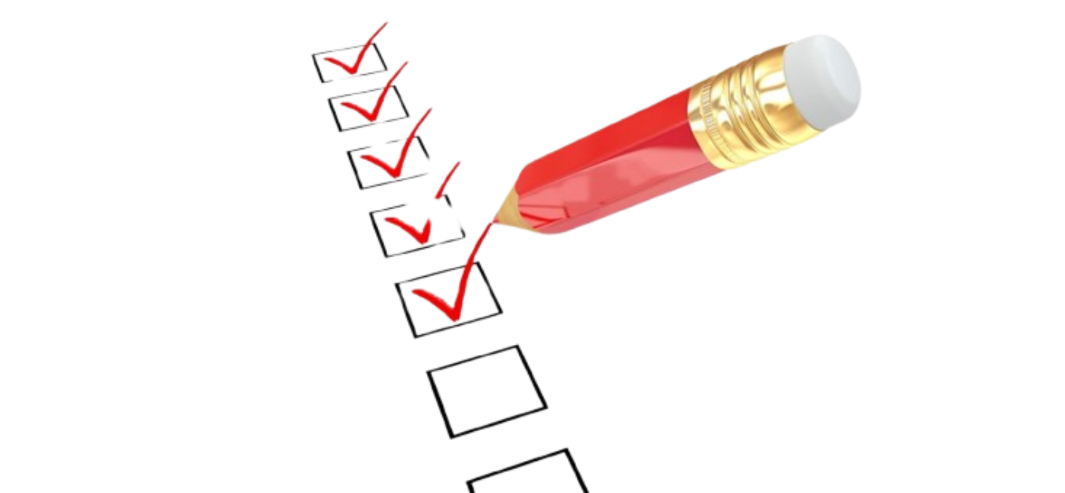


Questionnaire
Major Components
In NODUS, we incorporated a questionnaire based on the DSM-V ADHD criteria to enhance our assessment process.
The questionnaire is filled out by an external observer or a legal guardian, providing an objective view of the child's behavior.
It evaluates three core areas:
Inattention
Hyperactivity
Impulsiveness
The questions are designed to measure the frequency and severity of these behaviors and the answers are processed based on the criteria mentioned in DSM-V.

Slide 12
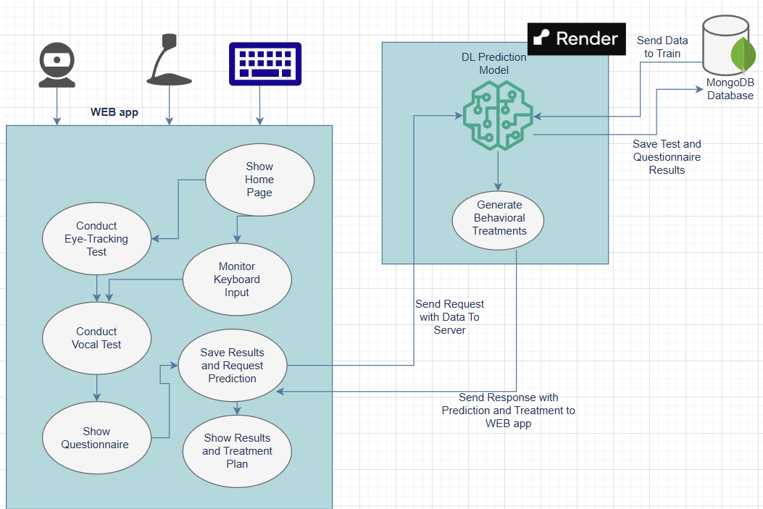
Overall Architecture
System Architecture

Slide 13
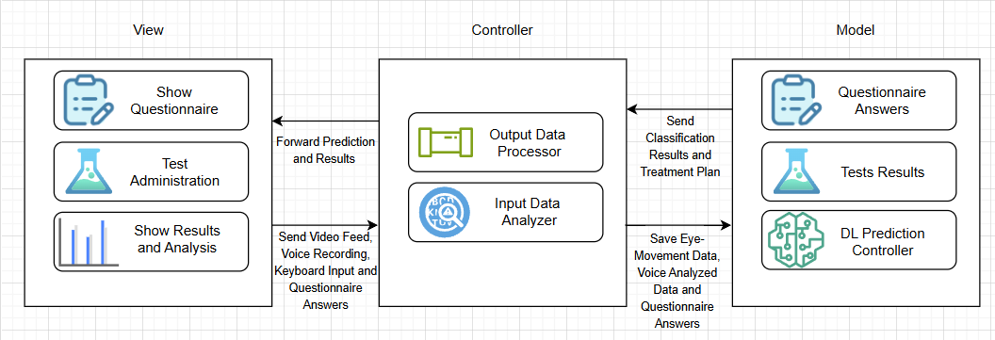
MVC Model
System Architecture
Presents the visual interactable elements to the user.
Sends input to controller
Translates data from the controller to a visual format
Handles user interaction and requests.
Manages the tests and questionnaires.
Is the middle-man between view and model.
Represents the core data and logic of the application.
Includes the DL prediction model.
Is responsible for saving data to database.

Slide 14





Tensorflow
PyMongo
OpenCV
Technologies Used
NIGGOLOGIIESUsed
Librosa
SoundFile
ParselMouth
Used to develop and train our DL Model.
Connecting the backend to the database.
Analyzing the eye tracking test.
Mainly utilized for Preprocessing audio files.
Used for writing the sound files into a suitable file format for manipulation by Librosa and ParselMouth
Extract detailed phonetic features and metrics, which will be fed into the DL model.

Slide 15


“No future proof system is complete without a sprinkle of Artificial Intelligence”
Greek Philosopher ChatGPT-4o

Slide 16


Deep Learning Model

Slide 17


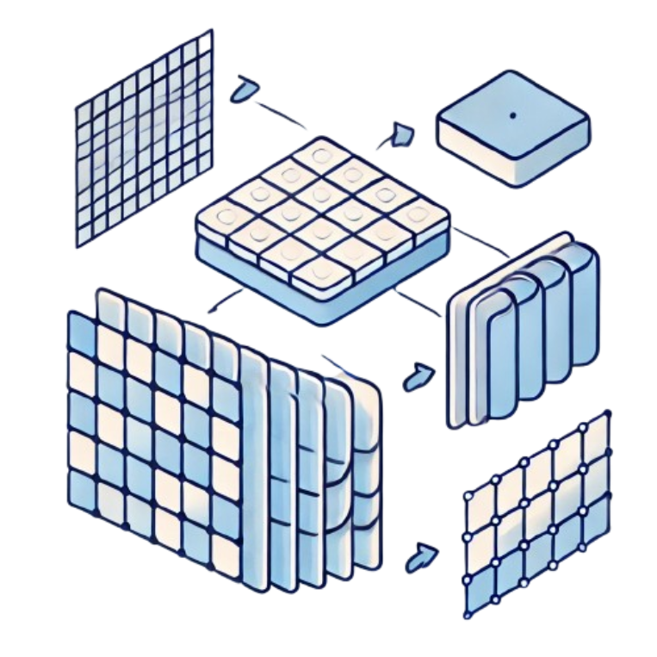
DL Model
Deep Learning
In NODUS, we employed a Convolutional Deep Learning model that sits in the back-end, this model is responsible for providing the subtype percentages.
This model was trained on behavioural data that we acquired using a beta version of the NODUS system.
All test results are pre-processed in the back-end and fed into this model, the results returned are simply the model’s predictions.
With the use of AI we allow our system to tackle new cases by comparing them with old cases it already came across.

Slide 18
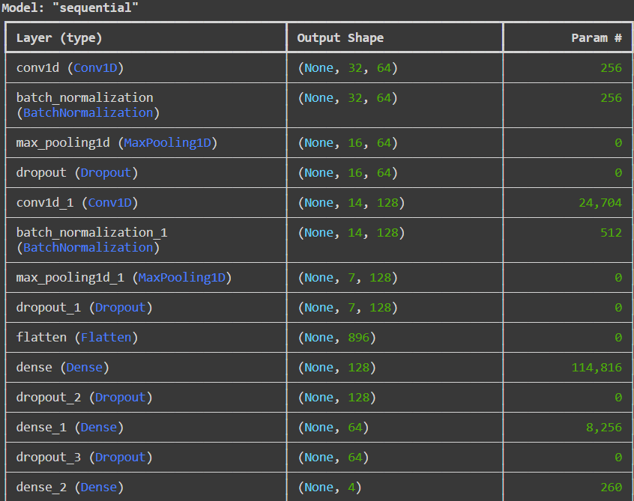
DL Model Architecture
Deep Learning Model
Conv1D Layers: Extract features from the input data using filters.
Batch Normalization: Normalizes the data to improve training stability and speed.
MaxPooling1D: Reduces the data size, making the model more efficient.
Dropout: Prevents overfitting by randomly turning off some neurons during training.
Flatten Layer: Prepares the data for the final decision-making layers.
Dense Layers: These fully connected layers make the final predictions based on the extracted features.

Slide 19
Phase 1
Phase 2
Phase 3
Experiment Setup
Training the DL model was done with data of 79 colleagues, 23 were labeled with a subtype of ADHD, spanning 3 phases:
Two system setups with microphones; tests done under supervision with participants. Data stored in MongoDB and labeled using ADHD prescriptions or DSM-V criteria for accurate supervised data.
Deep Learning Model
Half of the participants tested under supervision, half remotely. Compared data consistency between settings. Labels assigned as in Phase 1 to assess system reliability in mixed conditions.
All tests conducted remotely without supervision. Labeled data using internal metrics due to lack of prescriptions. Evaluated system performance in unsupervised conditions to finalize data collection.

Slide 20
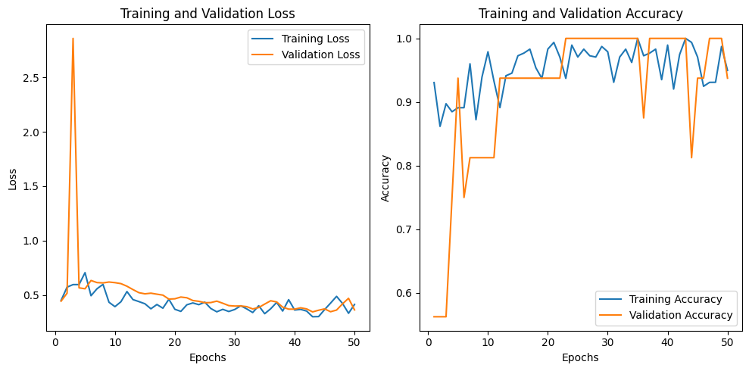
Training and Results
Deep Learning Model
This graph shows the training and validation loss (left) and accuracy (right) over 50 epochs. Training loss decreases steadily, while validation loss stabilizes after an initial spike. Both training and validation accuracy improve quickly and stay high, with some small fluctuations.

Slide 21
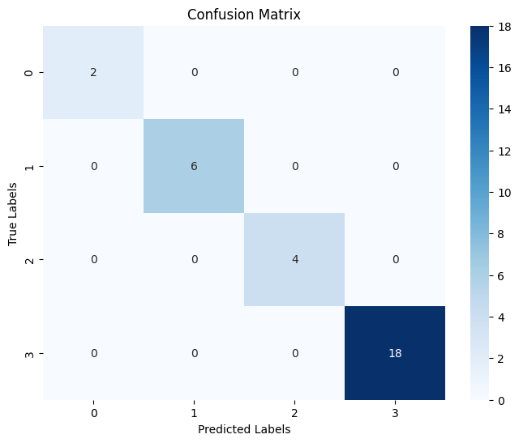
Training and Results
Deep Learning Model
This confusion matrix shows the classification performance of 30 samples from the validation set across four classes:
Class 0 (Combined type)
Class 1 (Hyperactive type)
Class 2 (Inattentive type)
Class 3 (Control group with no ADHD)
The model correctly classified most samples. There were no major misclassifications, indicating good performance across all classes.

Slide 22

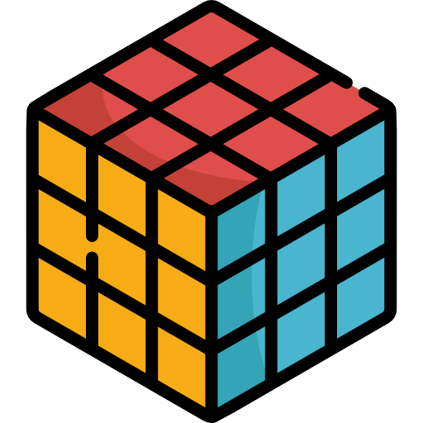

Challenges
Challenges
Data Acquisition and Experimentation
We faced difficulty finding concrete data to train our ADHD detection model due to the scarcity of ADHD datasets. We decided to collect in-house data through experiments with ADHD and non-ADHD participants, which presented challenges in participant recruitment and data consistency.
Deployment Challenges
Initially, we used AWS EC2 for deployment but faced complexity and cost issues. We switched to Render, which simplified deployment but introduced limitations like slower performance due to resource constraints, affecting our website’s responsiveness during peak times.

Slide 23
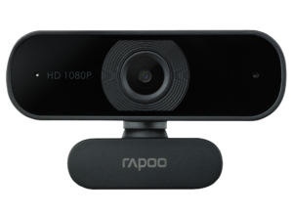
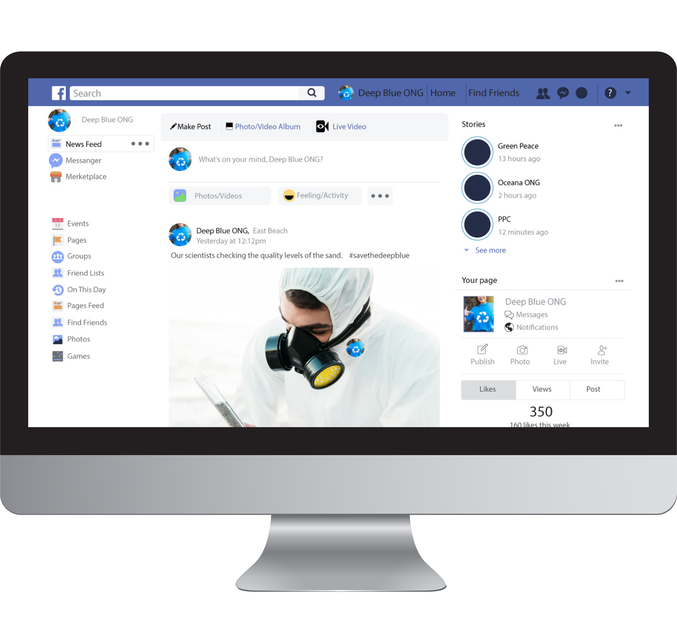
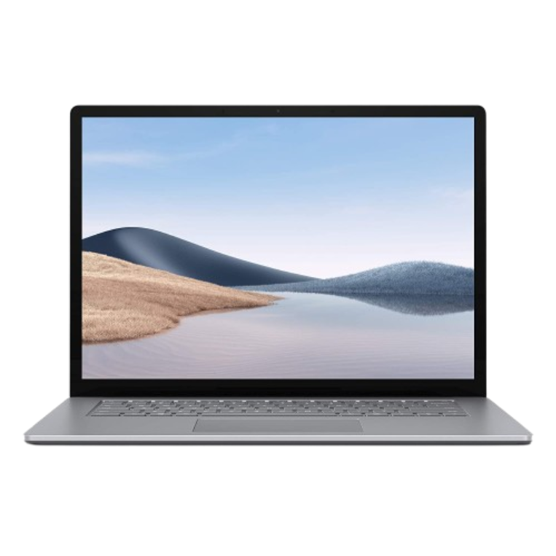
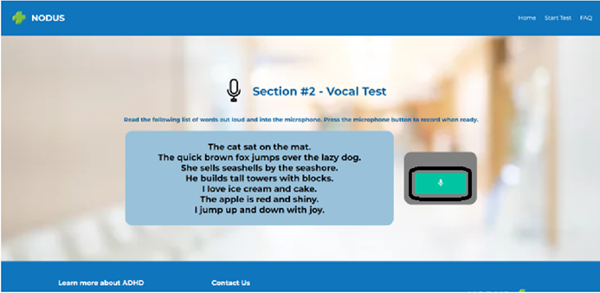
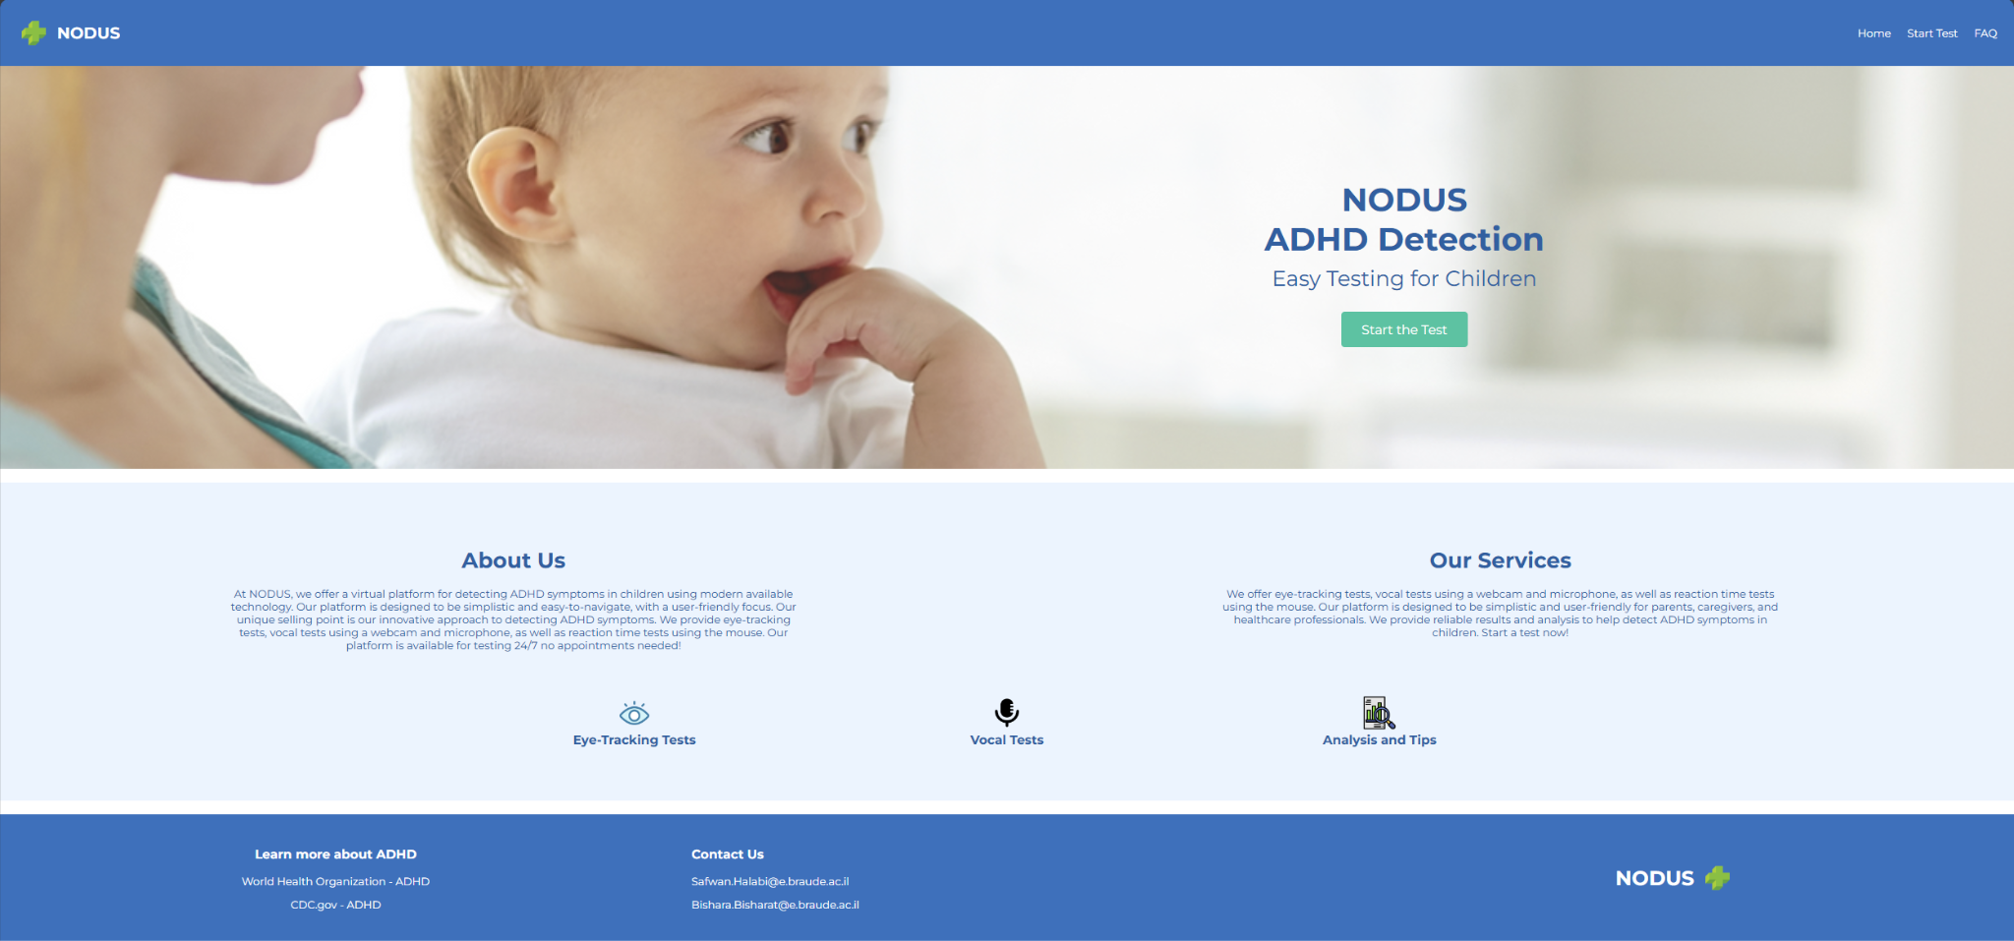
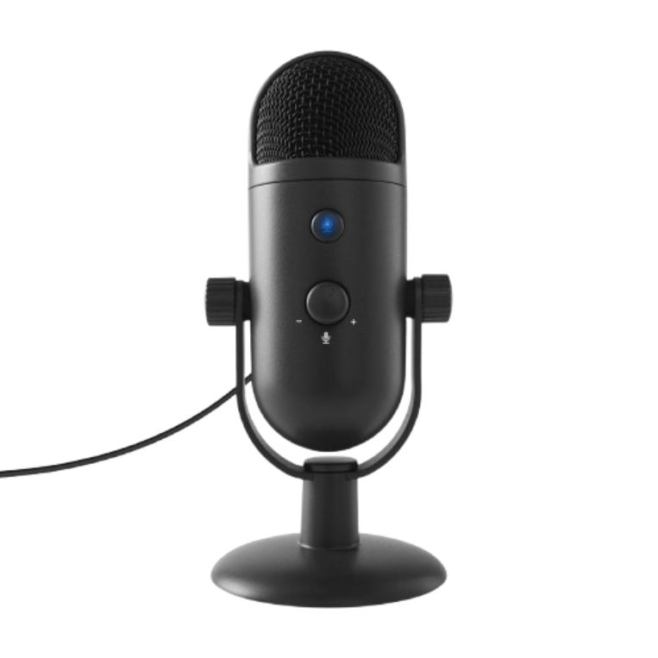
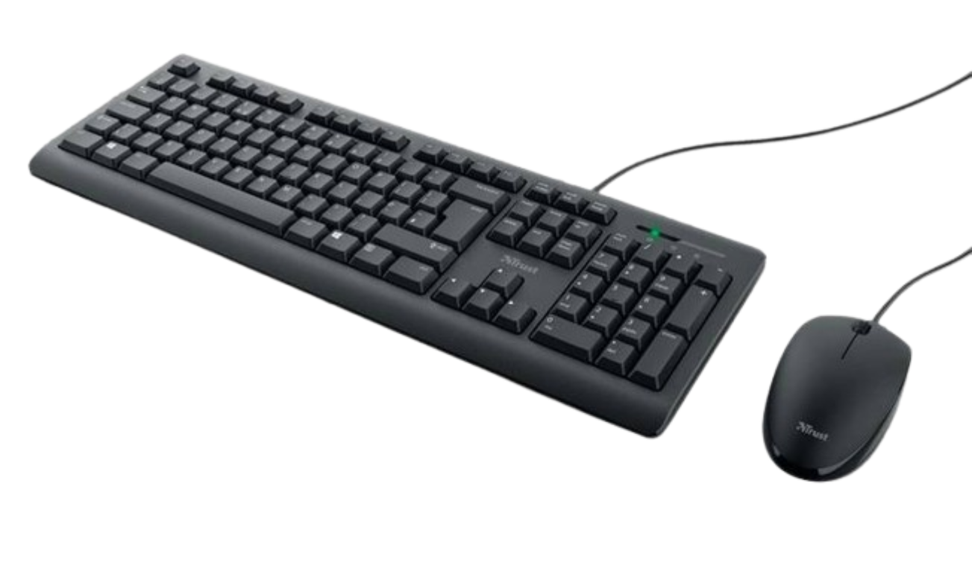
Final Product
Screenshots from the NODUS system

Slide 24

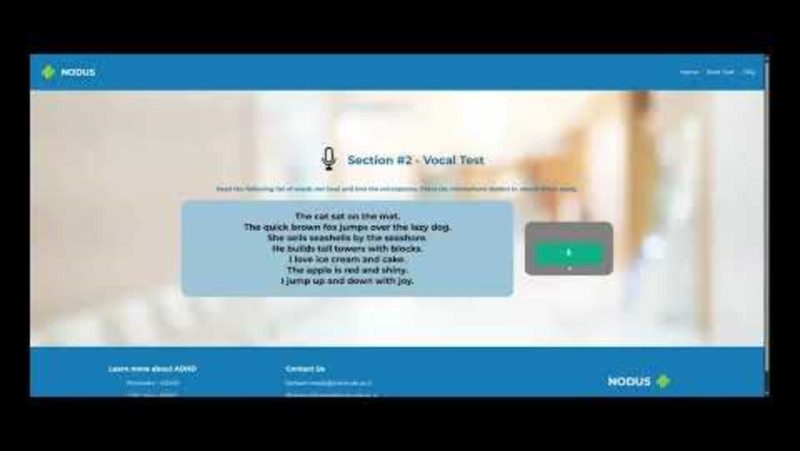



Slide 26

THANKS
Does anyone have any questions?
Follow the project updates
Safwan Halabi - Soon-to-be Software Engineer
Bishara Bisharat - Soon-to-be Software Engineer
(Depending on how this presentation goes)

